Slide 1

Hadoop
Cloudera
Trainer:- Deep Pandey

Slide 2
Introduction to BIG Data

Slide 3
DATA
Recorded values
Individual pieces of information
Unprocessed
…
Processing System
Data
Information

Slide 4
DATA SOURCES
Mobile Data
Server Logs
Scientific Data
Social Media Data
DATA
Environmental Data
Agricultural Data
Financial Data
Industrial Data

Slide 5

DATA CLASSIFICATION
DATA
STRUCTURED DATA
UNSTRUCTURED DATA
BIG DATA

Slide 6
BIG DATA IDENTIFICATION
Data Velocity
Real Time
Batch
Data Variety
KB
Text
SMS
Videos
MB
GB
TB
Volume:- How much data
Velocity:- How fast is processing
Variety:- Types of Data
Data Volume

Slide 7








VERACITY
eCommerce

Slide 8

CHALLENGES
Data Storage
Data Manipulation

Slide 9
Tea Break

Slide 10
Introduction to Hadoop

Slide 11

HADOOP
Apache Hadoop is a framework that allows for the distributed processing of large data sets, across clusters of commodity computers using a simple programming model.

Slide 12
HADOOP STRUCTURE
Hadoop
HDFS
Name Node
Data Node
MapReduce
Job Tracker
Task Tracker

Slide 13
HADOOP ARCHITECTURE
master
slave
slave
Task Tracker
Task Tracker
Task Tracker
MapReduce Layer
Job
Tracker
HDFS Layer
Name Node
Data Node
Data Node
Data
Node
Multi-Node Cluster

Slide 14
MODERN DATA ARCHITECTURE
APPLICATIONS
BUSINESS
ANALYSIS
CUSTOM
APPLICATION
PACKAGED
APPLICATION
DATA SYSTEMS
0
HADOOP
REPOSITORY
SOURCES
EXISTING
SOURCES
EMERGING
SOURCES

Slide 15
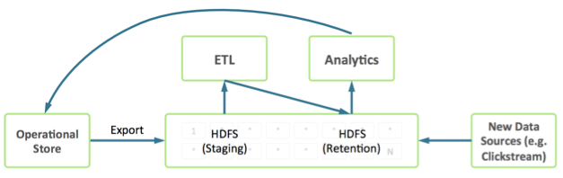
HADOOP IMPLEMENTATION

Slide 16











YARN
SPARK
FLUME
ZOOKEEPER
PIG
SHARK
STORM
HBASE
HIVE
SQOOP
OOZIE

Slide 17
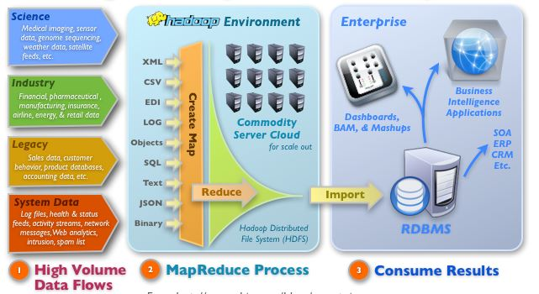
HADOOP IMPLEMENTATION

Slide 18
Lunch Break

Slide 19
Introduction to HDFS

Slide 20
HDFS CHARACTERSTICS
Involve Commodity Servers.
Supports parallel reading and processing of data.
Built-in Redundancy.
Automatically manage addition and removal of nodes.
Versatile, resilient and clustered approach to manage files.
Breaks Data into Data Blocks.
Default Size of Data Block :- 128 MB.
Replication is done to maintain the availability of Data.
Default Replication Factor = 3
Comprise of NameNode, DataNode and Secondary NameNode

Slide 21
HDFS COMPONENTS
NAMENODE
Master of the system
Maintains and Manages the blocks which are present on the data nodes
DATANODE
Slaves which are deployed on each machine and provide the actual storage.
Responsible for serving Read and Write requests for the clients.
SECONDARY NAMENODE
Reads data from RAM and writes the same to Hard Disk.

Slide 22
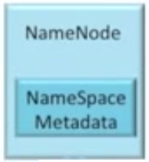
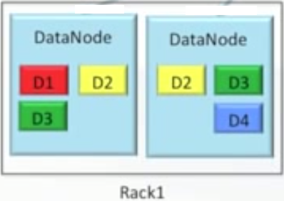
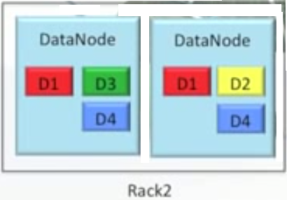
HDFS STRUCTURE

Slide 23
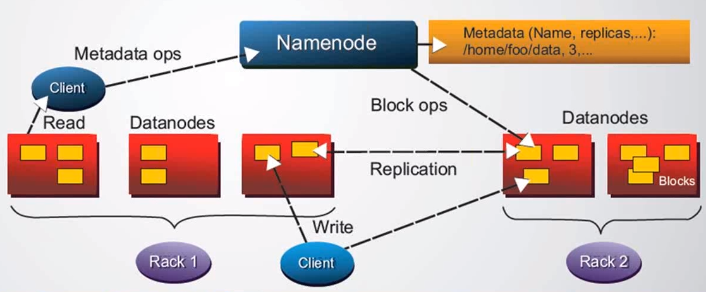
HDFS ARCHITECTURE

Slide 24
METADATA IN NAMENODE
Fsimage:- Complete snapshot of the file system metadata
Edits:- Only incremental modifications made to the metadata
SECONDARY NAMENODE
Namenode after loading the FSImage, has the whole snapshot of where data is stored in memory.
Transactions are coming in and that information is stored in Editlog.
Periodically every hour the secondary namenode retrieves the logs and merges them with the latest fsimage and keeps the data as a checkpoint. At this point the namenode has the image in the memory. The editlogs are emptied and the latest checkpoint is stored as an image on secondary namenode.
LOCATION:- dfs.namenode.name.dir in hdfs-site.xml

Slide 25
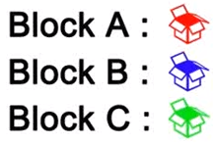
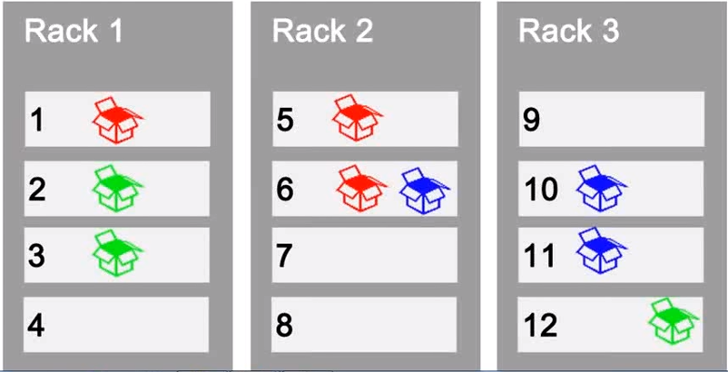
RACK AWARENESS

Slide 26
NEW FILE CREATION
AddBlock Request
DataNode Details
NameNode
HDFS
Client
Write
DataNode
DataNode
DataNode

Slide 27
FILE WRITING
AddBlock Request
DataNode Details
NameNode
HDFS
Client
Write
DataNode
Acknowledgement
DataNode
DataNode

Slide 28
FILE READING
Get Block Location
DataNode Details
NameNode
HDFS
Client
DataNode
Read
DataNode
DataNode

Slide 29
REPLICATION
UNDER REPLICATION:-
No. of Blocks < Replication Factor
OVER REPLICATION
No. of Blocks > Replication Factor
To check Replication Factor
hadoop fs -ls
or
hadoop fs -stat

Slide 30
CONFIGURING REPLICATION FACTOR
hdfs-site.xml
<property>
<name>dfs.replication<name>
<value>3<value>
<description>Block Replication<description>
<property>
Using hadoop fs commands
replication factor on a per-file basis using the Hadoop FS shell.
$ hadoop fs –setrep –w 3 /my/file
replication factor of all the files under a directory.
$ hadoop fs –setrep –w 3 -R /my/dir

Slide 31
CONFIGURING BLOCK SIZE
hdfs-site.xml:
<property>
<name>dfs.block.size<name>
<value>134217728<value>
<description>Block size<description>
<property>

Slide 32
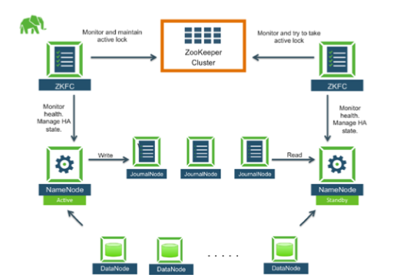
NAMENODE AVAILABILITY

Slide 33
Tea Break

Slide 34
Introduction to MapReduce

Slide 35
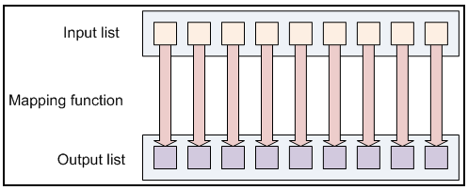
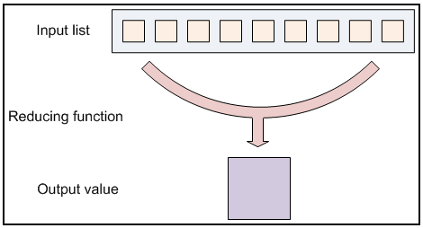
MAPREDUCE
Programming model designed to process data in parallel by dividing work into set of independent tasks.
MapReduce programs are written like Functional Programming constructs.
The job configuration supplies map and reduce analysis functions and the hadoop framework provides the scheduling, distribution and parallelization services.
The fundamental working of MapReduce is Key value Pairs

Slide 36
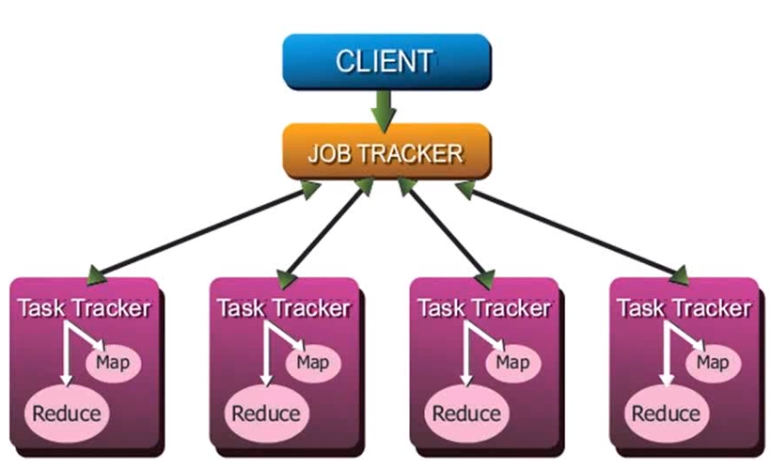
DAEMONS OF MAPREDUCE

Slide 37
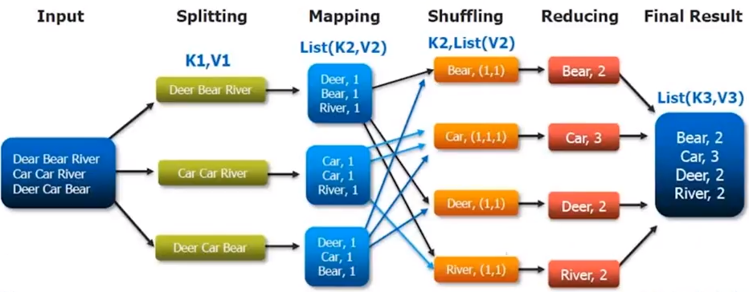
MAPREDUCE PARADIGM

Slide 38
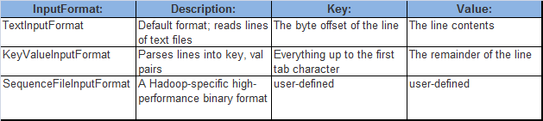
FILE TYPES AND FORMATS
INPUT FILES:-
Data for MapReduce task and resides in HDFS.
INPUT FORMATS:-
Java Class that selects, split and read the files for Input.
Desired Input format can be chosen, based on the job.
Method to be called is setInputFormat() of jobConfObject.

Slide 39

FILE TYPES AND FORMATS
OUTPUT FILES:-
Key, Value pairs provided by output are written here.
OUTPUT FORMATS:-
Method to be called is setOutputFormat() of jobConfObject.

Slide 40
Sample MapReduce Program
Mapper Class
import java.io.IOException;
import org.apache.hadoop.io.IntWritable;
import org.apache.hadoop.io.Text;
import org.apache.hadoop.mapreduce.Mapper;
public class VoteCountMapper extends Mapper<Object, Text, Text, IntWritable> {
private final static IntWritable one = new IntWritable(1);
@Override
public void map(Object key, Text value, Context output) throws IOException, InterruptedException {
//If more than one word is present, split using white space.
String[] words = value.toString().split(" ");
//Only the first word is the candidate name
output.write(new Text(words[0]), one);
}
}

Slide 41
Sample MapReduce Program
Reducer Class
import java.io.IOException;
import java.util.Iterator;
import org.apache.hadoop.io.IntWritable;
import org.apache.hadoop.io.Text;
import org.apache.hadoop.mapreduce.Reducer;
public class VoteCountReducer extends Reducer<Text, IntWritable, Text, IntWritable> {
@Override
public void reduce(Text key, Iterable<IntWritable> values, Context output) throws IOException, InterruptedException {
int voteCount = 0;
for(IntWritable value: values)
{ voteCount+= value.get();
}
output.write(key, new IntWritable(voteCount));
}
}

Slide 42
Application / Driver Class
import org.apache.hadoop.conf.Configuration;
import org.apache.hadoop.conf.Configured;
import org.apache.hadoop.fs.Path;
import org.apache.hadoop.io.IntWritable;
import org.apache.hadoop.io.Text;
import org.apache.hadoop.mapreduce.Job;
import org.apache.hadoop.mapreduce.lib.input.FileInputFormat;
import org.apache.hadoop.mapreduce.lib.input.TextInputFormat;
import org.apache.hadoop.mapreduce.lib.output.FileOutputFormat;
import org.apache.hadoop.mapreduce.lib.output.TextOutputFormat;
import org.apache.hadoop.util.Tool;
import org.apache.hadoop.util.ToolRunner;
public class VoteCountApplication extends Configured implements Tool{
public static void main(String[] args) throws Exception {
int res = ToolRunner.run(new Configuration(),
new VoteCountApplication(), args); System.exit(res); }
@Override
public int run(String[] args) throws Exception {
if (args.length != 2) {
System.out.println("usage: [input] [output]");
System.exit(-1);
}
Job job = Job.getInstance(new Configuration()); job.setOutputKeyClass(Text.class); job.setOutputValueClass(IntWritable.class); job.setMapperClass(VoteCountMapper.class); job.setReducerClass(VoteCountReducer.class); job.setInputFormatClass(TextInputFormat.class); job.setOutputFormatClass(TextOutputFormat.class); FileInputFormat.setInputPaths(job, new Path(args[0])); FileOutputFormat.setOutputPath(job, new Path(args[1])); job.setJarByClass(VoteCountApplication.class); job.submit(); return 0;
}
}

Slide 43
COMBINERS
MAPPER 1
MAPPER 2
MAPPER 3
MAPPER 4
COMBINER 1
COMBINER 2
REDUCER 1
OUTPUT

Slide 44
COUNTERS
USE OF COUNTERS:-
Job Statistics
Quality Control
Application Level Statistics
Problem Diagnosis
Built In Counters
Task Counters
Job Counters
User Defined Java Counters

Slide 45
Introduction to YARN

Slide 46
WEB APPS
Presentation Layer
Presentation Layer
Presentation Layer
Business Logic
Business Logic
Business Logic
DATABASE

Slide 47
WHAT IF …
MapReduce is not the only thing that I want to run.
I would like to do Real Time Analysis
My Cluster has more compute capacity than the requirement of my Big Data.
Can’tI utilize its idle resources for other compute intensive tasks.

Slide 48
YARN APPLICATION MANAGER
AM
AM
RESOURCE MANAGER
DATABASE

Slide 49
YARN : HOW IT WORKS
Every Node (or machine) in the cluster have several slots.
A Node Manager runs on each node to manage the node’s slot.
The Resource Manager assigns the slots of the cluster to application.
Applications must have a Master.
The Master requests slots from the Resource Manager and starts Task.

Slide 50
PROTOCOLS
NODE MANAGER
CLIENT-RM: Submit the App Master
RM-NM: Start the App Master
AM-RM: Request / Release Containers
RM-NM: Start Tasks in Container
AM
YARN (RESOURCE MANAGER)
YARN (CLIENT)
NODE MANAGER
TASK

Slide 51
BACKGROUND : HADOOP + HDFS
Every Node contributes part of its local filesystem to HDFS.
Tasks can only depend upon the local file system (JVM Classpath does not understand HDFS protocol)
NAMENODE
DATANODE
DATANODE
LOCAL FILESYSTEM
LOCAL FILESYSTEM
HADOOP DISTRIBUTED FILE SYSTEM

Slide 52
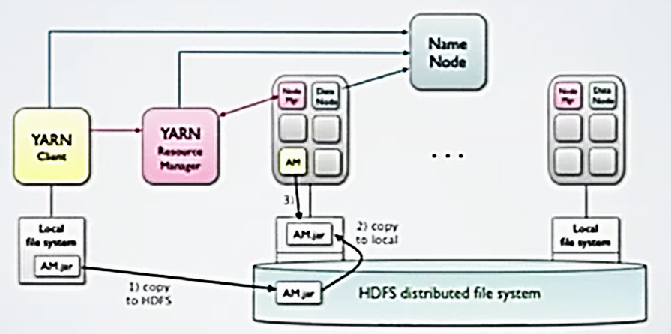

Slide 53
WRITING THE YARN CLIENT
Connect to the Resource Manager.
Request a New Application ID
Create a Submission context and a container launch context
Define the local resource for the Application Manager
Define the environment for the Application Manager
Define Resource Limits for Application Manager
Submit the Request to Start the App Master

Slide 54
YARN : APPLICATION MASTER
Connect with Resource Manager
Loop:
Send Request to Resource Manager to:-
Send HeartBeat
Request Containers
Release Containers
Receive response from Resource Manager
Receive Containers
Receive Notification of Containers that terminated
For each container received, send request to node manager to start task.

Slide 55
YARN : APPLICATION MASTER
Application Master should terminate after all the containers have terminated.
Starting a task in a Container:-
Very similar to YARN Client starting the Master.
Node Manager starts and monitor tasks.
If task crashes, Node Manager informs Resource Manager.
Resource Manager informs master in Next Response.
Master must still release the container
Resource Manager assigns Containers asynchronously
Requested Containers are returned at the earliest in the next call.
Master must send empty requests until it receives all containers.
Subsequent Requests are incremental and can ask for additional containers.
Master must keep track of what it has requested and received.

Slide 56
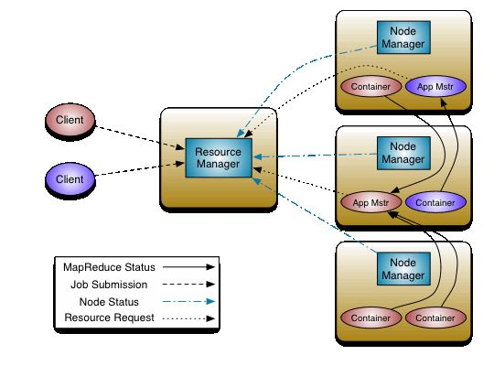
YARN : ARCHITECTURE

Slide 57
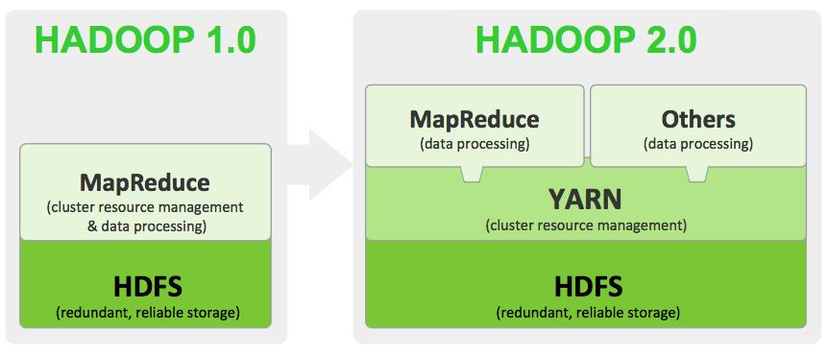
HADOOP : NEXT GEN PLATFORM

Slide 58
BENEFITS OF YARN
New Application and Services.
Improved Cluster Utilization
Scalable
Experimental Agility
Shared Services

